Slide 1

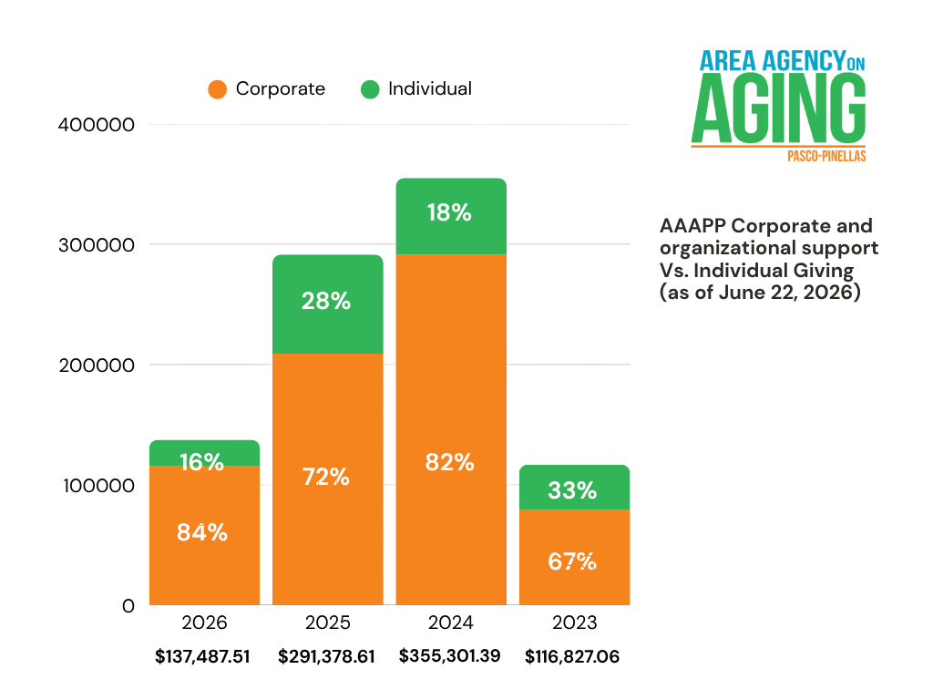
July 2026
Advisory Council Meeting

Slide 2
July 2026
Advisory Council Meeting
Donor Communication & Metrics
May 20 - US Senate Special Committee on Aging announcement
Sent 1:21pm on May 20
  Sent to 810 contacts
  42% open rate
  6.3% Click through rate
Also shared on Facebook & LinkedIn. AAAPP received several seplies and comments on socials re: Christine Diddion’s Destimony to the committee.
May Newsletter -
First wave - Sent April 30 8:39am
  Sent to 793 Contacts
  42% Open rate
  7% Clickthrough rate
As new contacts are added via our website I send them this newsletter. as of June 3
  Sent to 821 contacts
  44.3% Open Rate
  7.5% Click through
Annual Luncheon - Presenting Sponsor Announcement
Sent June 2, 2026
  Sent to 811 Contacts
  40.1% Open rate
  5.4% Clickthrough rate
World Elder Abuse Day
Florida webinar event
Sent June 5, 2026
  819 contacts
  40% Open Rate
  5% Clickthrough
Contact Growth last 30 Days: 21

Slide 3
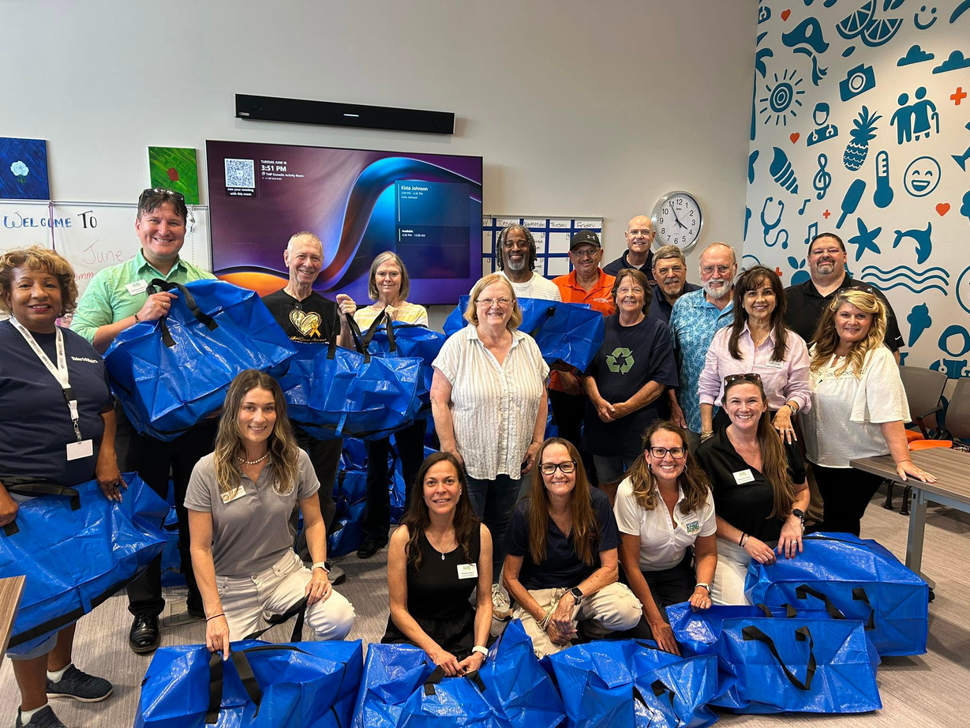
July 2026
Advisory Council Meeting
June 16, 2026
Volunteer Event
100 hurricane kits packed for Pinellas County Seniors.
Funded by Duke Energy
Hosted by ArchWell Health

Slide 4

July 2026
Advisory Council Meeting
Save the Date!
July 15, 2026
Pasco Volunteer Event
Please RSVP to
Melissa Lawrence
melissa.lawrence@aaapp.org

Slide 5

July 2026
Advisory Council Meeting
2026 Funds Raised vs. Goal
As of June 3 we are at 45.8% of
our 2026 annual goal of $300,000.

Slide 6
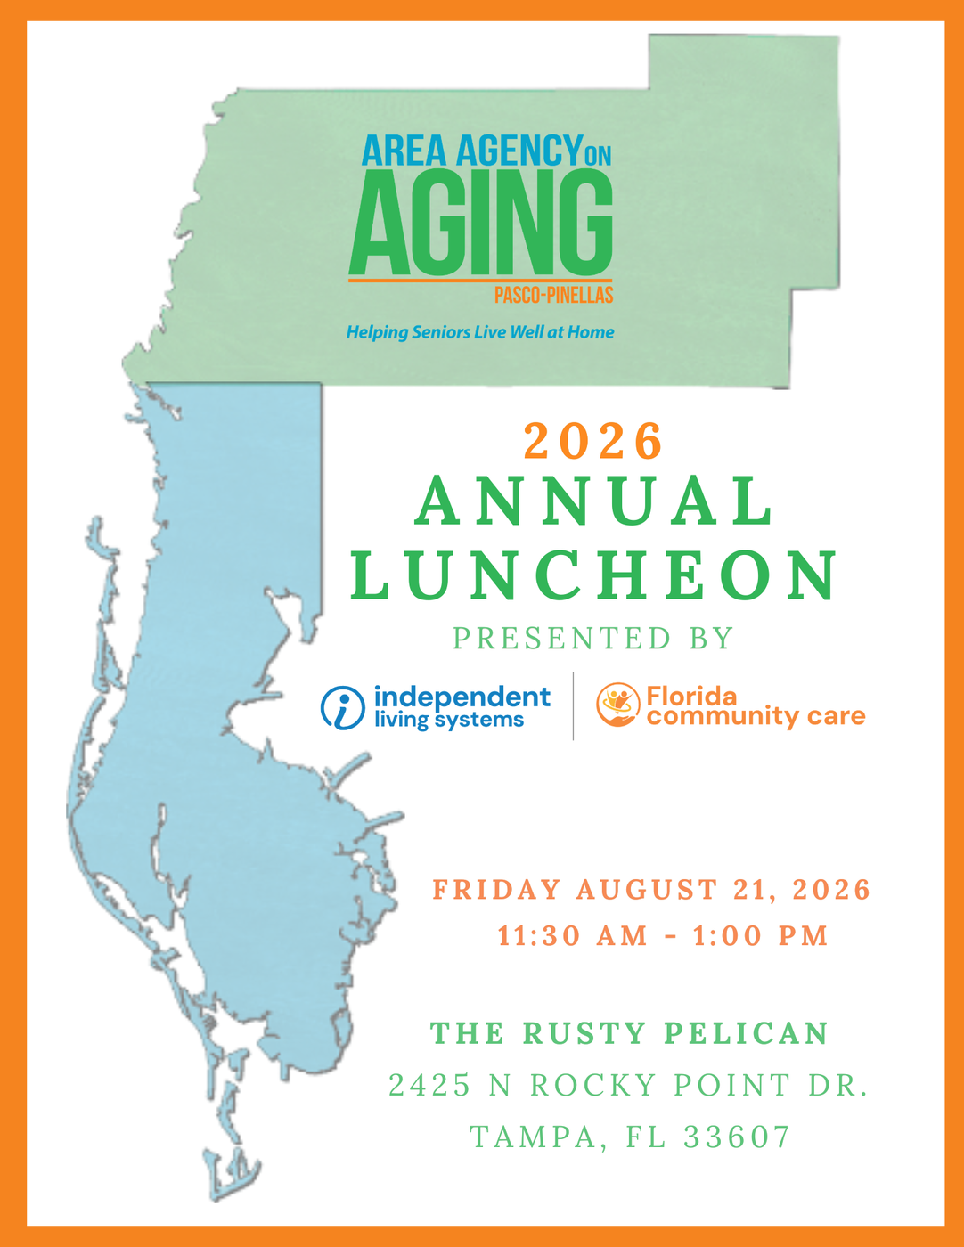

July 2026
Advisory Council Meeting
2026 Annual Luncheon
Presented by:
Friday August 21, 2026
The Rusty Pelican
11:30-1:00pm

Slide 7
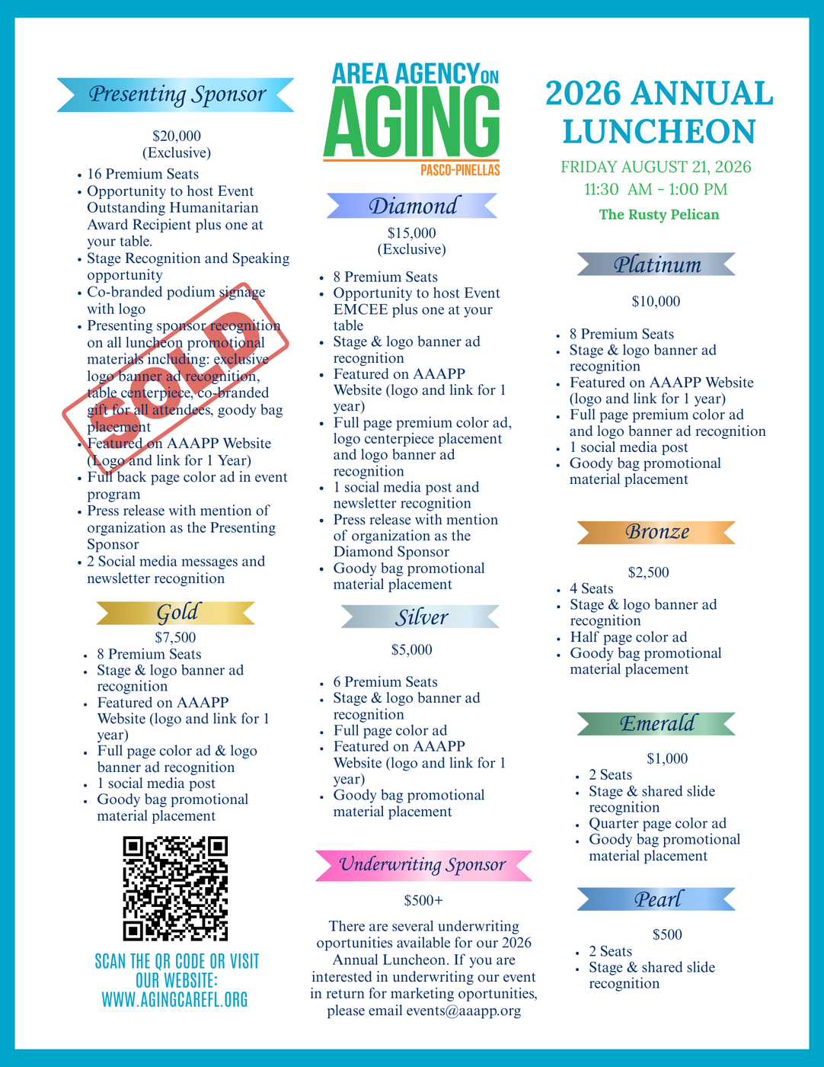
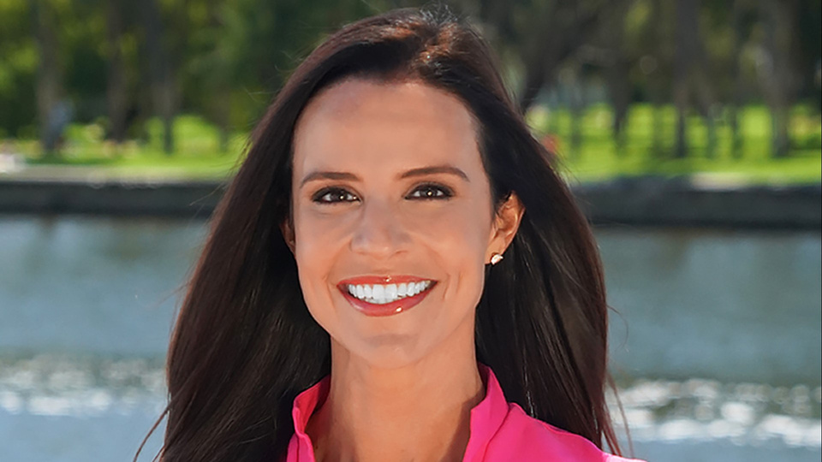
July 2026
Advisory Council Meeting
Benefit for 2026 Annual Luncheon
  Funds raised for the 2026 Annual Luncheon are to be unrestricted, in order to promote and support AAAPP and its mission to provide Wrap around care and services to seniors in Pasco and Pinellas Counties.
  Sponsorship Packet
    Updated with Presenting Sponsor co-branding
  Website - Bloomerang Link
  Emcee - Courtney Robinson, Anchor 10 Tampa Bay

Slide 8
July 2026
Advisory Council Meeting
Current Committed and or Pledged Sponsors:
$97,850.00
Presenting - ILS/FCC
Gold:
  ArchWell Health
Silver:
  Amerilife
  BayCare Health Sysetm, Inc.
  David Alvarez/Carr, Riggs and Ingram
  Dominium
  Pinellas County Housing Authority
  Richert Quarles, PA
Bronze:
  Better Living for Seniors
  HKH Elder Law
  Neighborly Home Care Network
  ReBuilt Meals
  Seacoast Bank
  Dr. Stuart & Mrs. Stephanie Strikowsky
  UBS/Matt Gordon
  WellMed
Emerald:
  Ann Marie Winter
  April Hill Esq.
  Barbara Epstein
  Brown & Brown
  Cavanaugh & Co.
  Dedicated Senior Medical Care
  Florida Representative Linda Chaney
  Guardian Angel Homecare Services
  Health Aid Company
  Humana
  Infotect Design Solutions
  Moore Insurance Options
  Norm Bungard
  SeaBreeze Adult Day Center
  Theresa Ziegler/Ruth’s Promise Adult Day Program
Pearl:
  Bay Area Legal Services
  Daycations Adult Daycare
  EXIT Suncoast Realty
  Gulf Coast JFCS
  Kristina Jalazo
  Lena Wilfalk
  Menorah Life
  Mutual of America
  Pinellas County Commissioner Dr. Rene Flowers
  Tawnya Martino

Slide 9

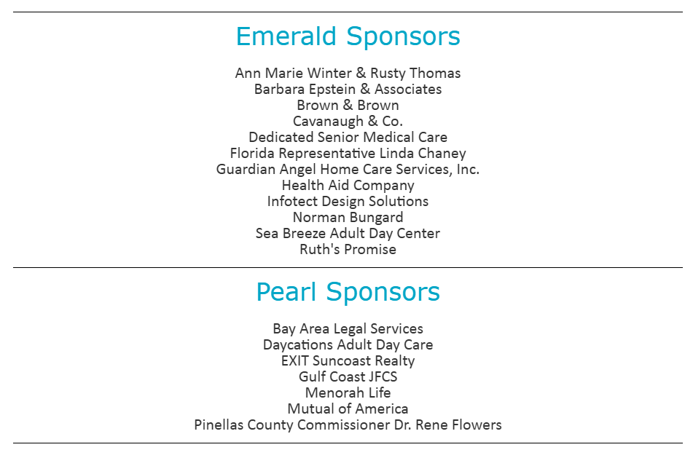




July 2026
Advisory Council Meeting
2026 Annual Luncheon website updates

Slide 10
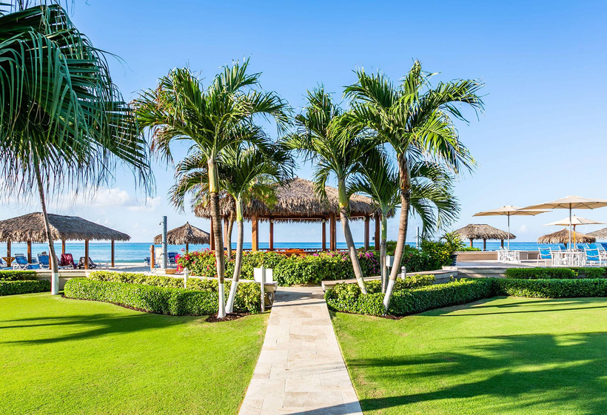
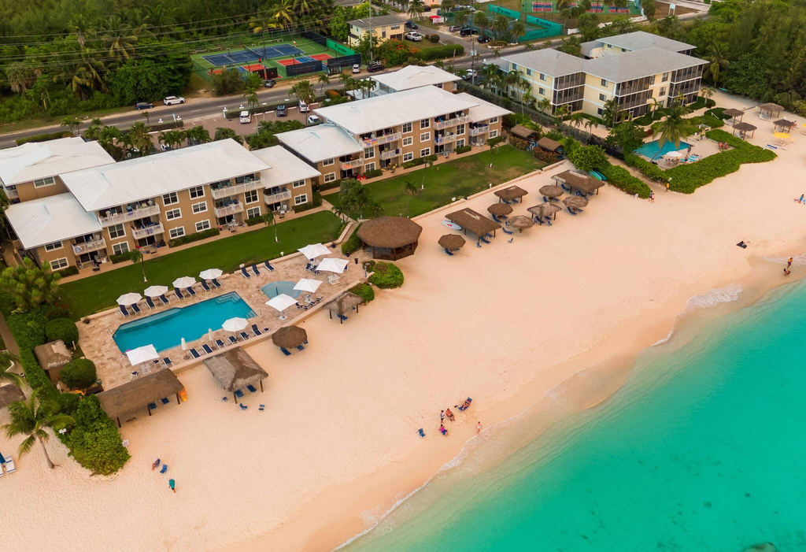
July 2026
Advisory Council Meeting
Featured In-Kind donation
Grand Cayman Getaway
Thanks to Judge Jirotka, we are honored to announce that he has graciously donated a week long stay in a garden-view condo that sleeps 4. This will be included in our day of fundraising efforts via auction.
We are looking to make this an incredible package offering for our attendees to include gift cards for airfare or a dining certificate from a local restaurant close to the condo location.
Additional in-kind support is needed and greatly appreciated!
Deadline to receive print recognition in 2026 Luncheon Program is July 27,2026

Slide 11
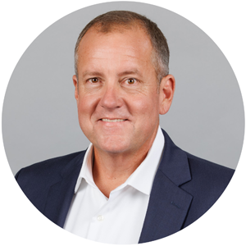
July 2026
Advisory Council Meeting
2026 Outstanding Humanitarian Honoree
Mike Wells
Pasco County Property Appraiser and former Pasco County Commissioner

